Slide 1
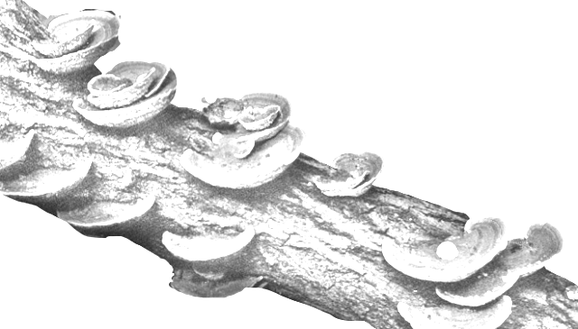
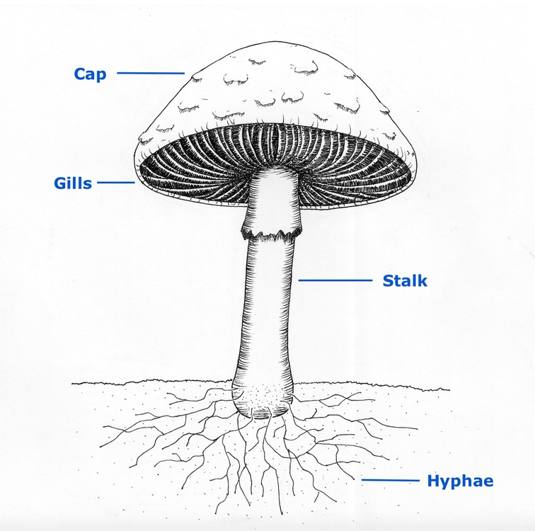

Slide 2
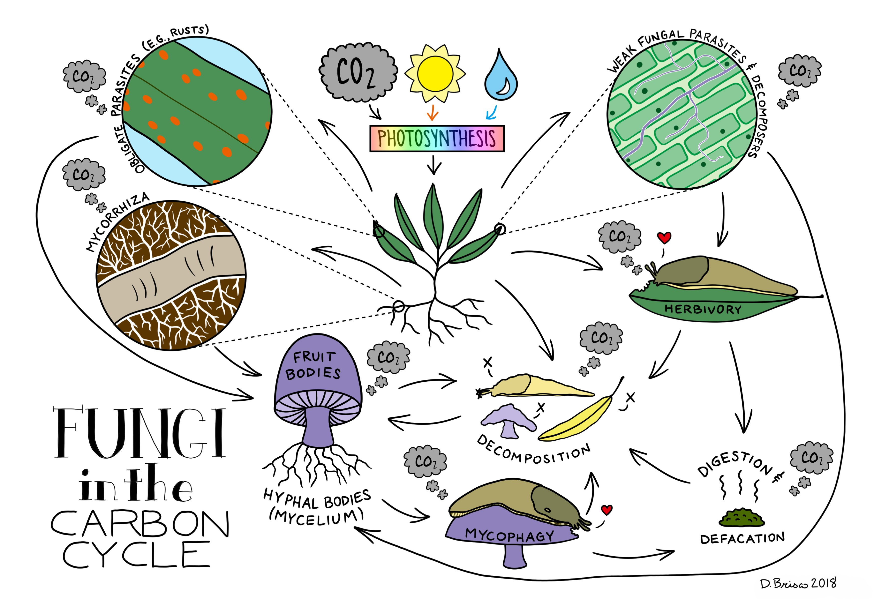

Slide 4
Temperature
Environmental Capacity
Blocking
Factor
Reproduction Rate
Competitive
Ranking
Population Size
Total Decomposition Rate
Decomposition Rate
Moisture
Niche
Width
Growth
Rate
Absorptivity
Moisture

Slide 5
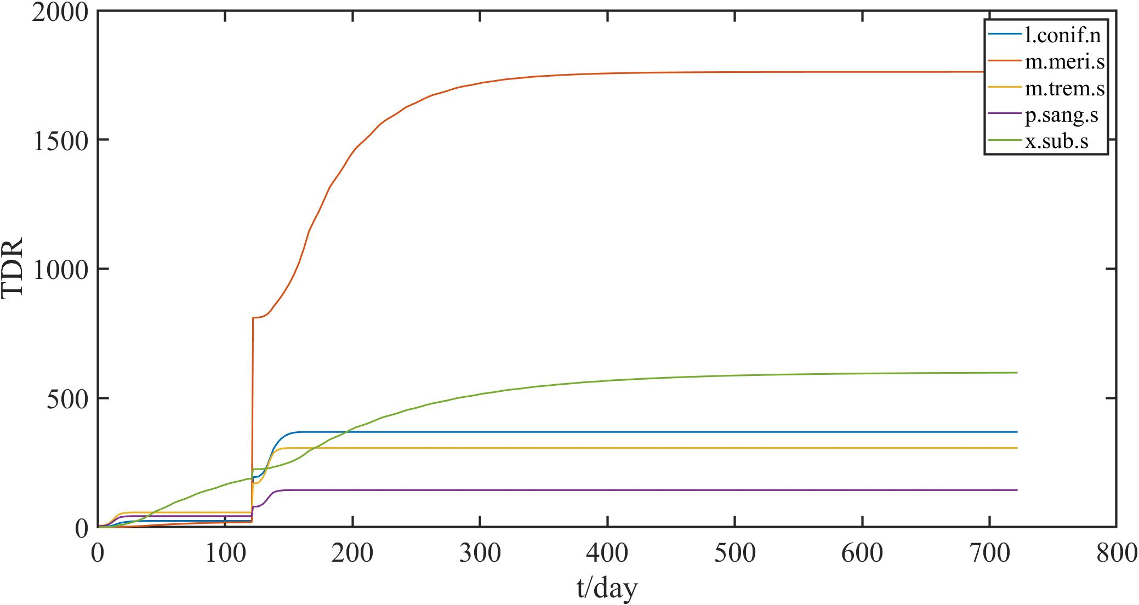
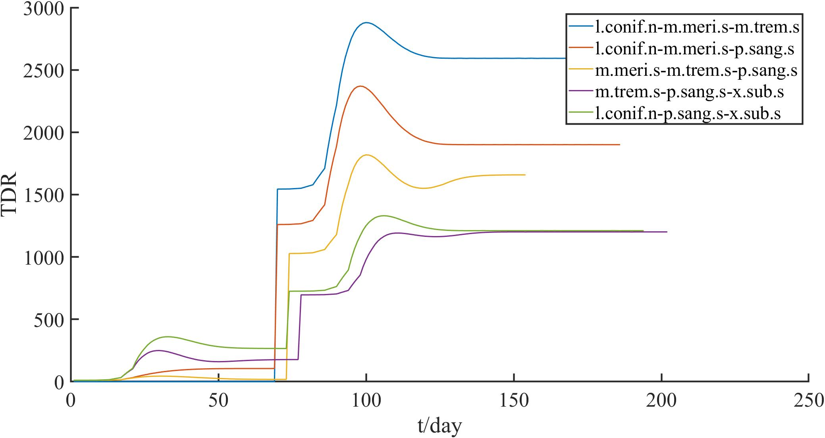
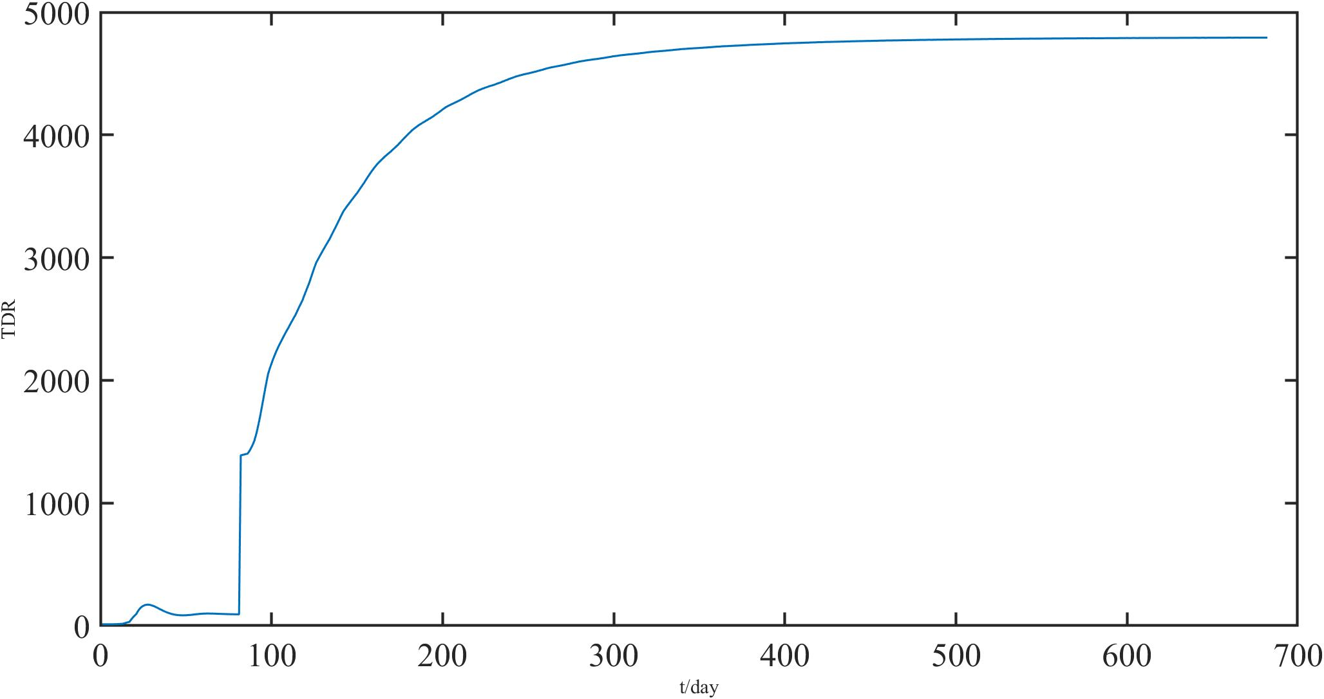
(40,-4.5)(20,-1) Arid
(a)
(b)
(c)

Slide 6
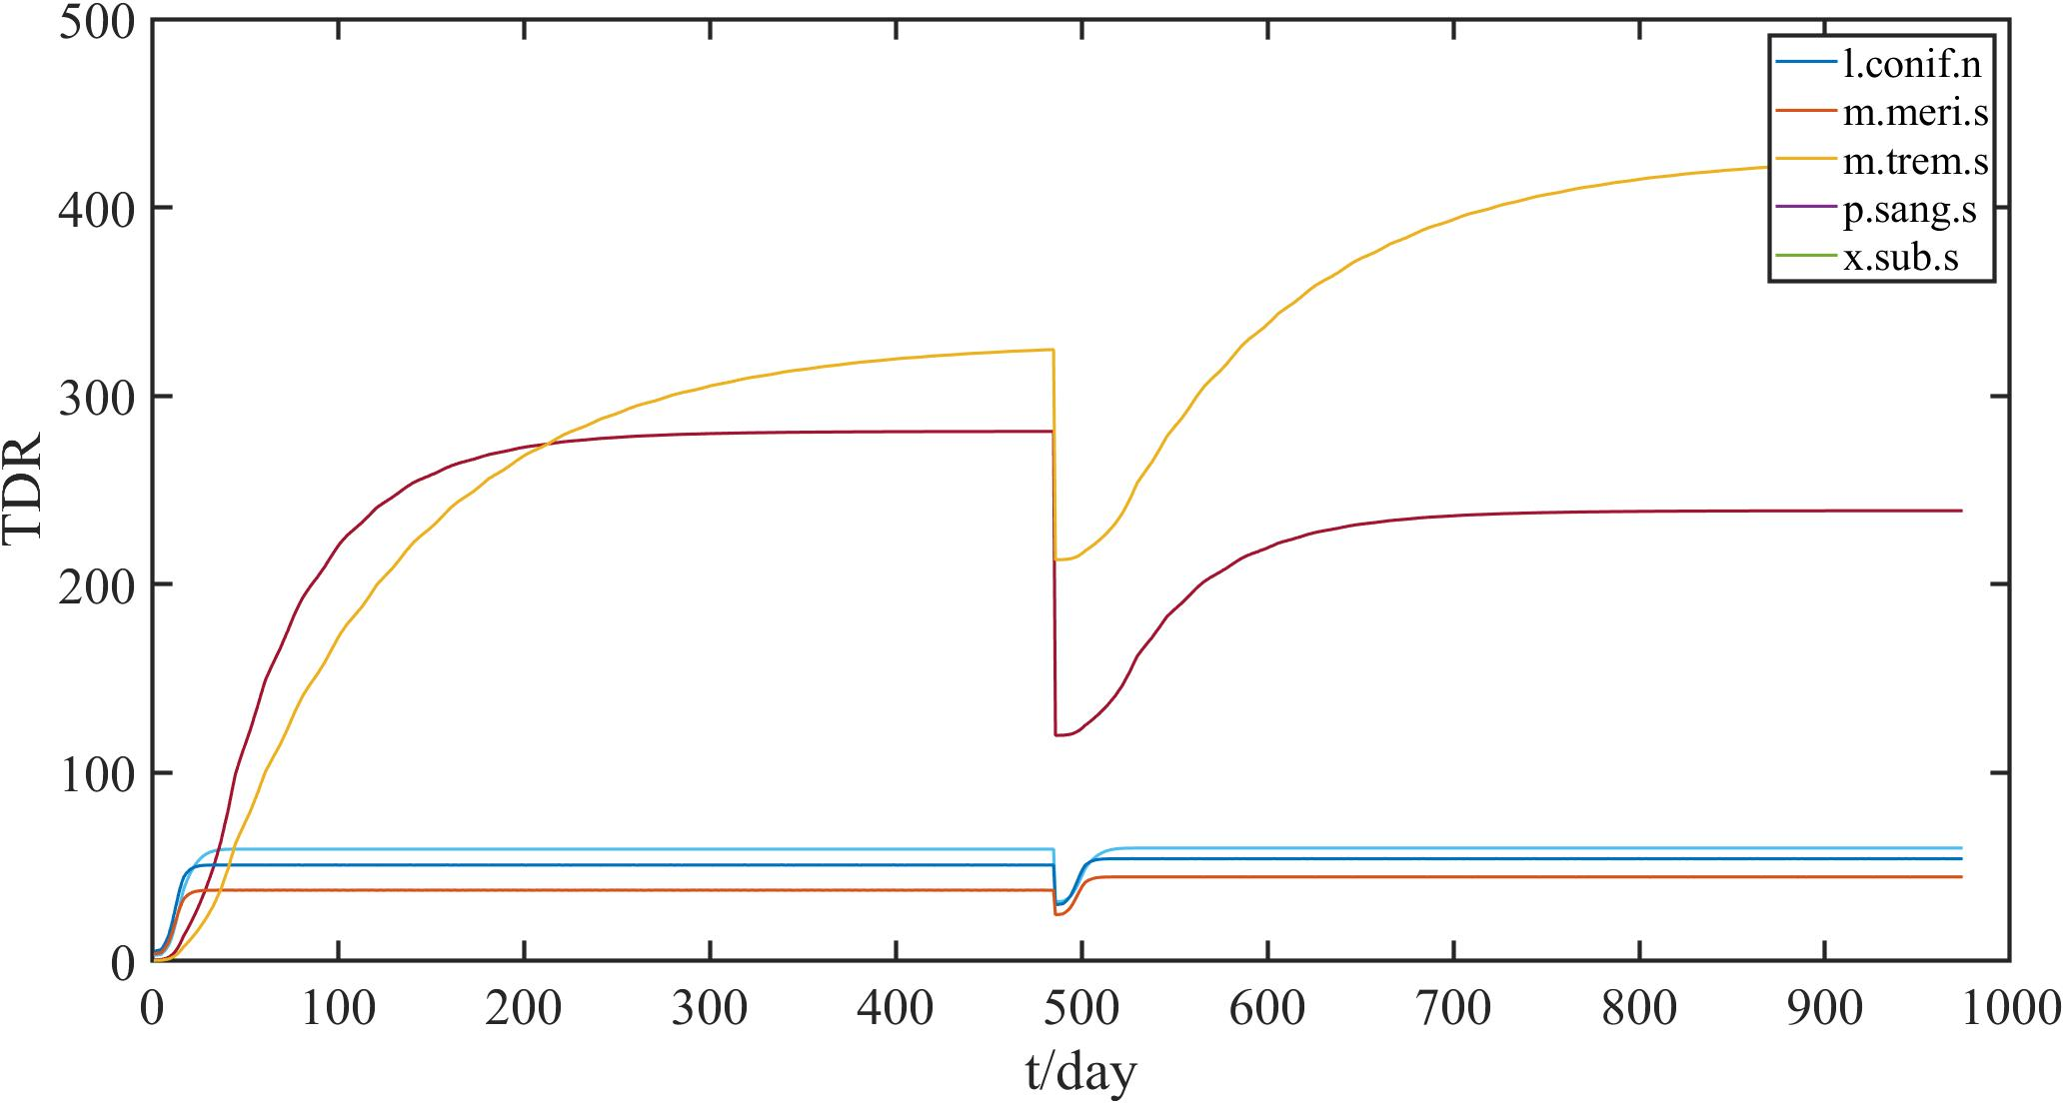
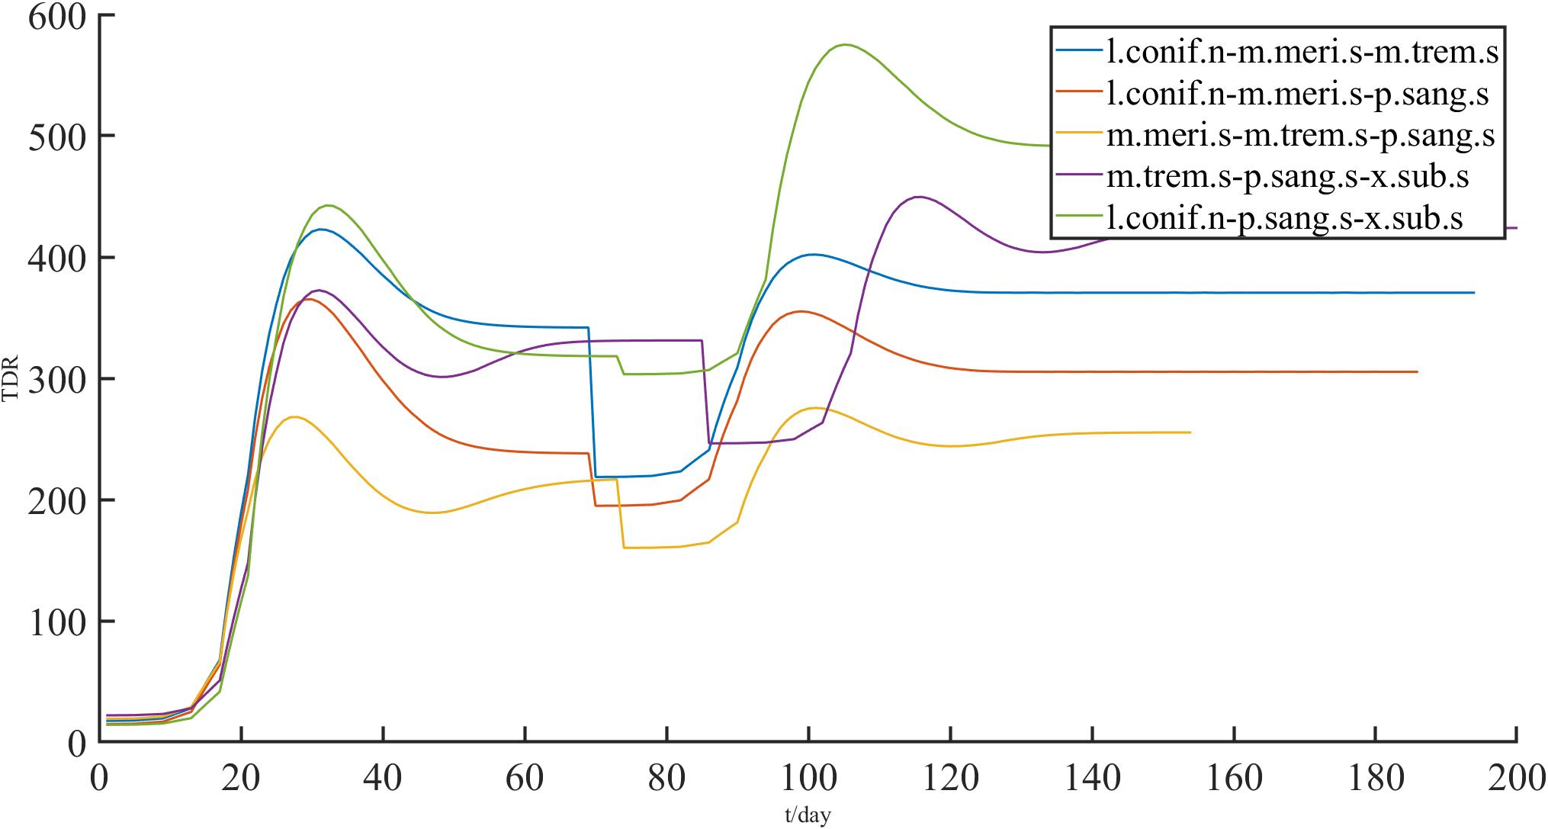
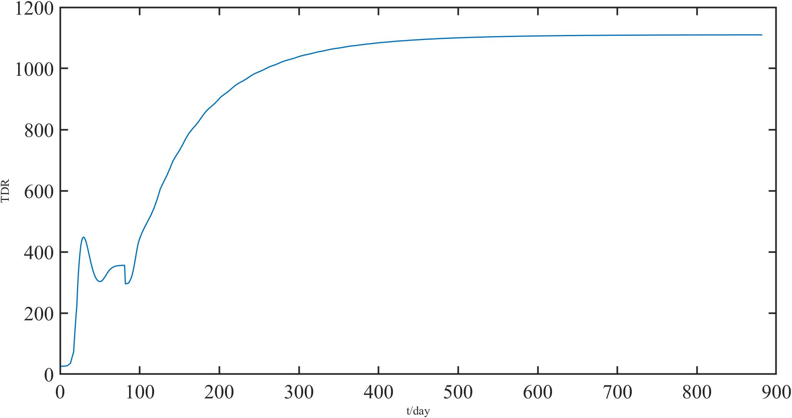
(15,-2)(5,-2)
Temprate
(a)
(b)
(c)

Slide 7
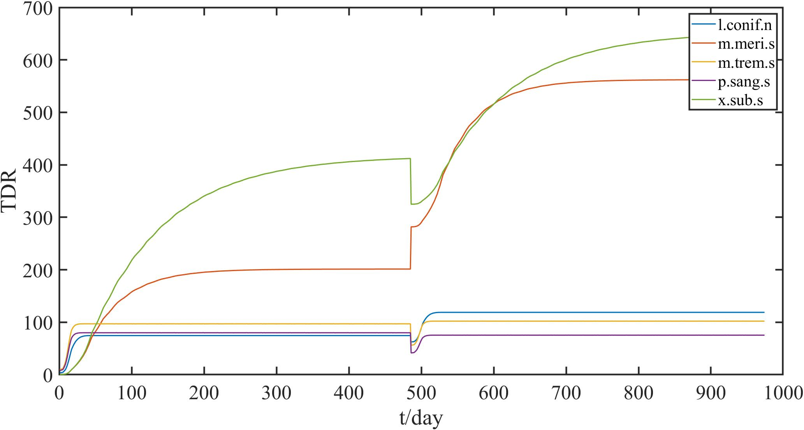
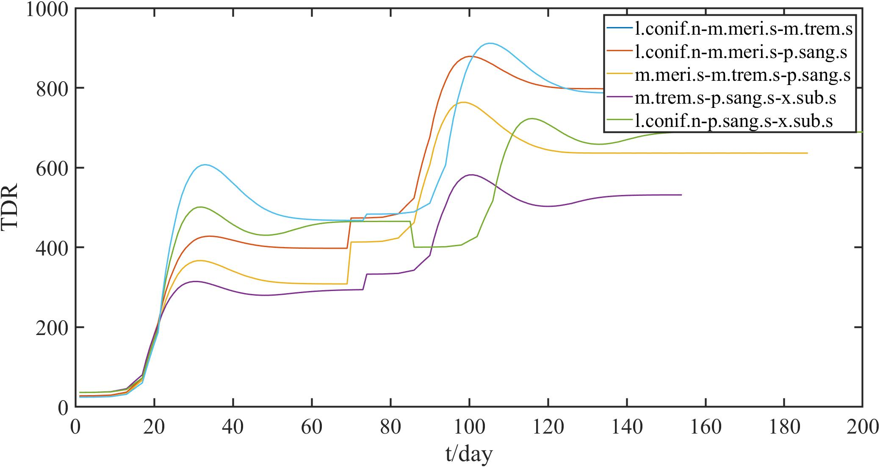
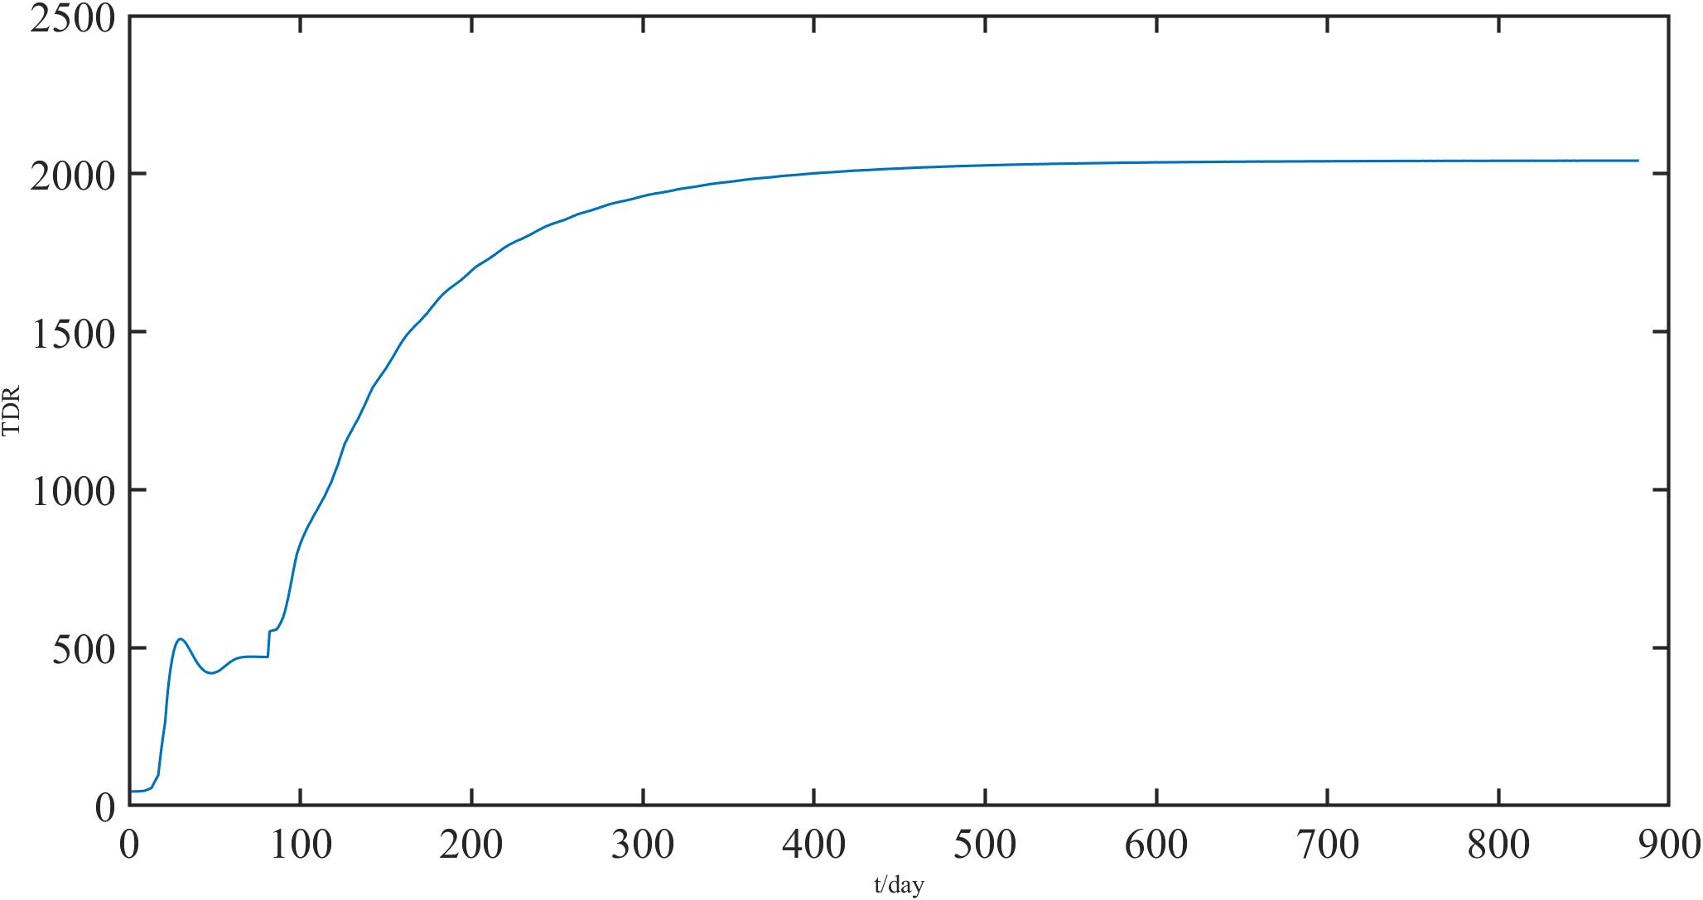
(30,-2)(15,-2) Semi Arid
(a)
(b)
(c)

Slide 8
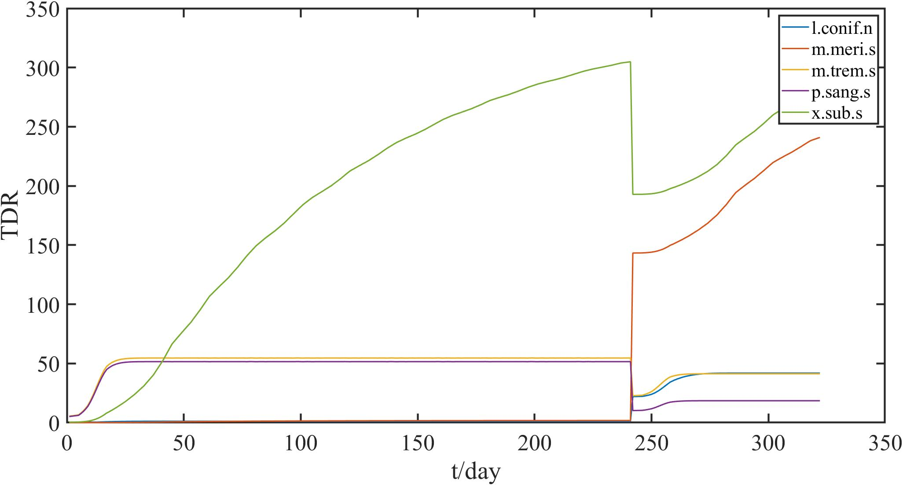
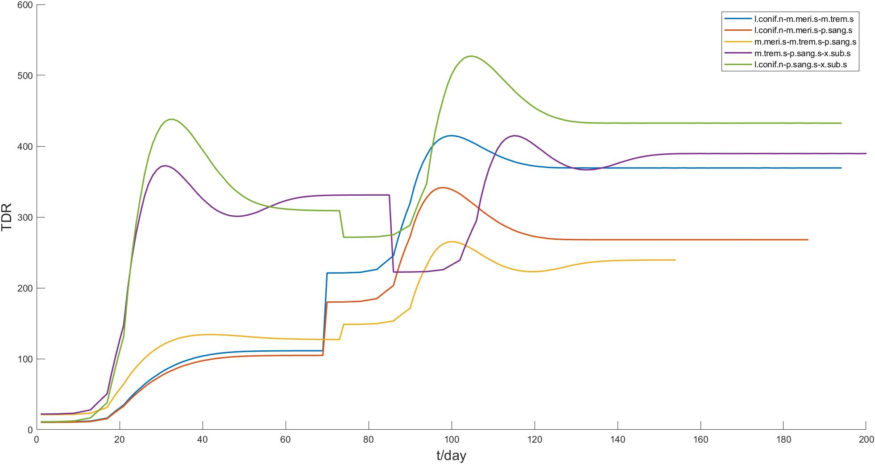
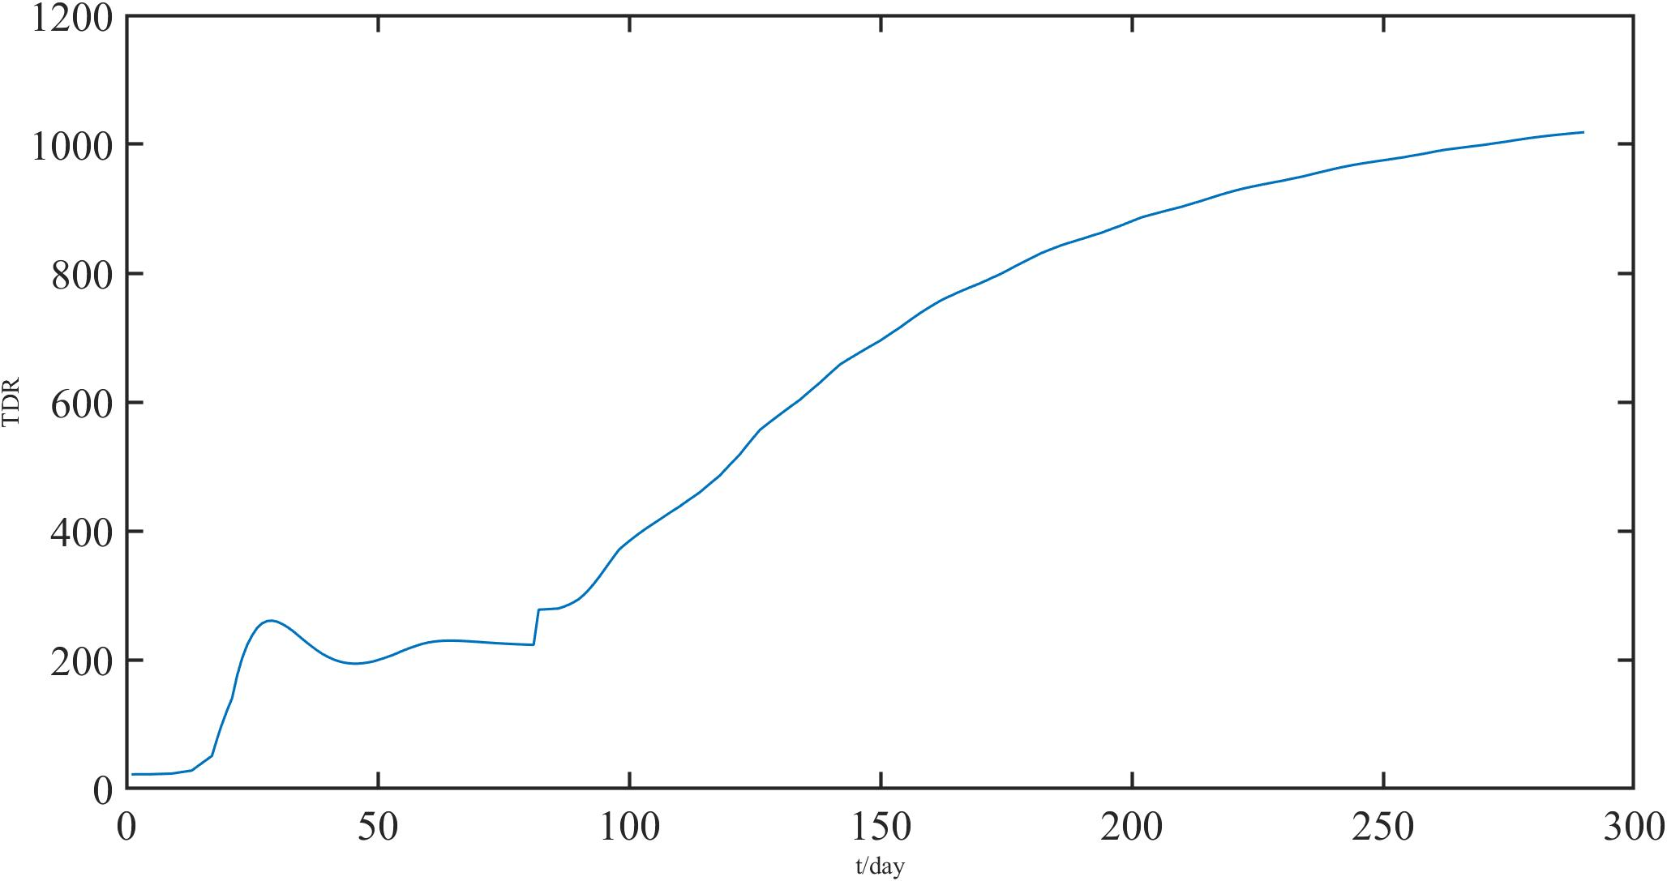
(32,-3.5)(15,-5)Aboreal
(a)
(b)
(c)

Slide 9
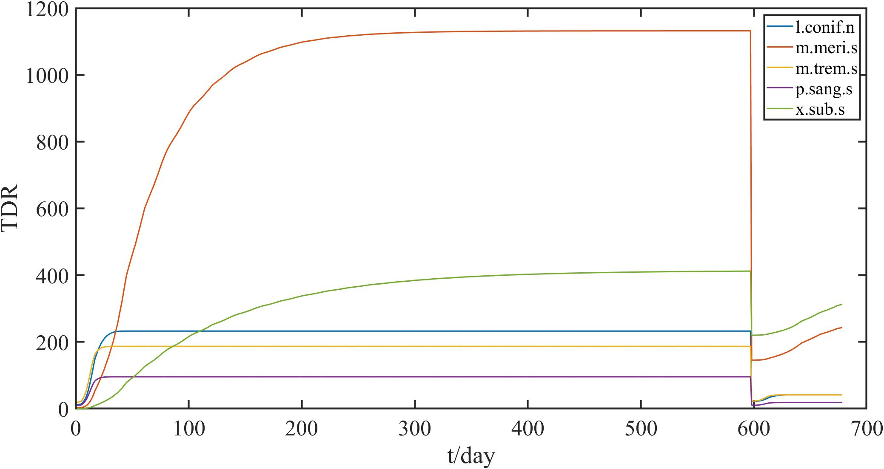
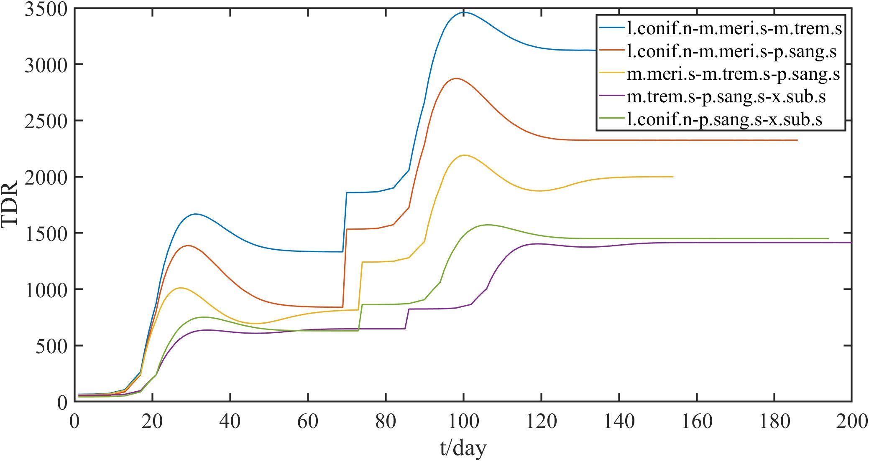
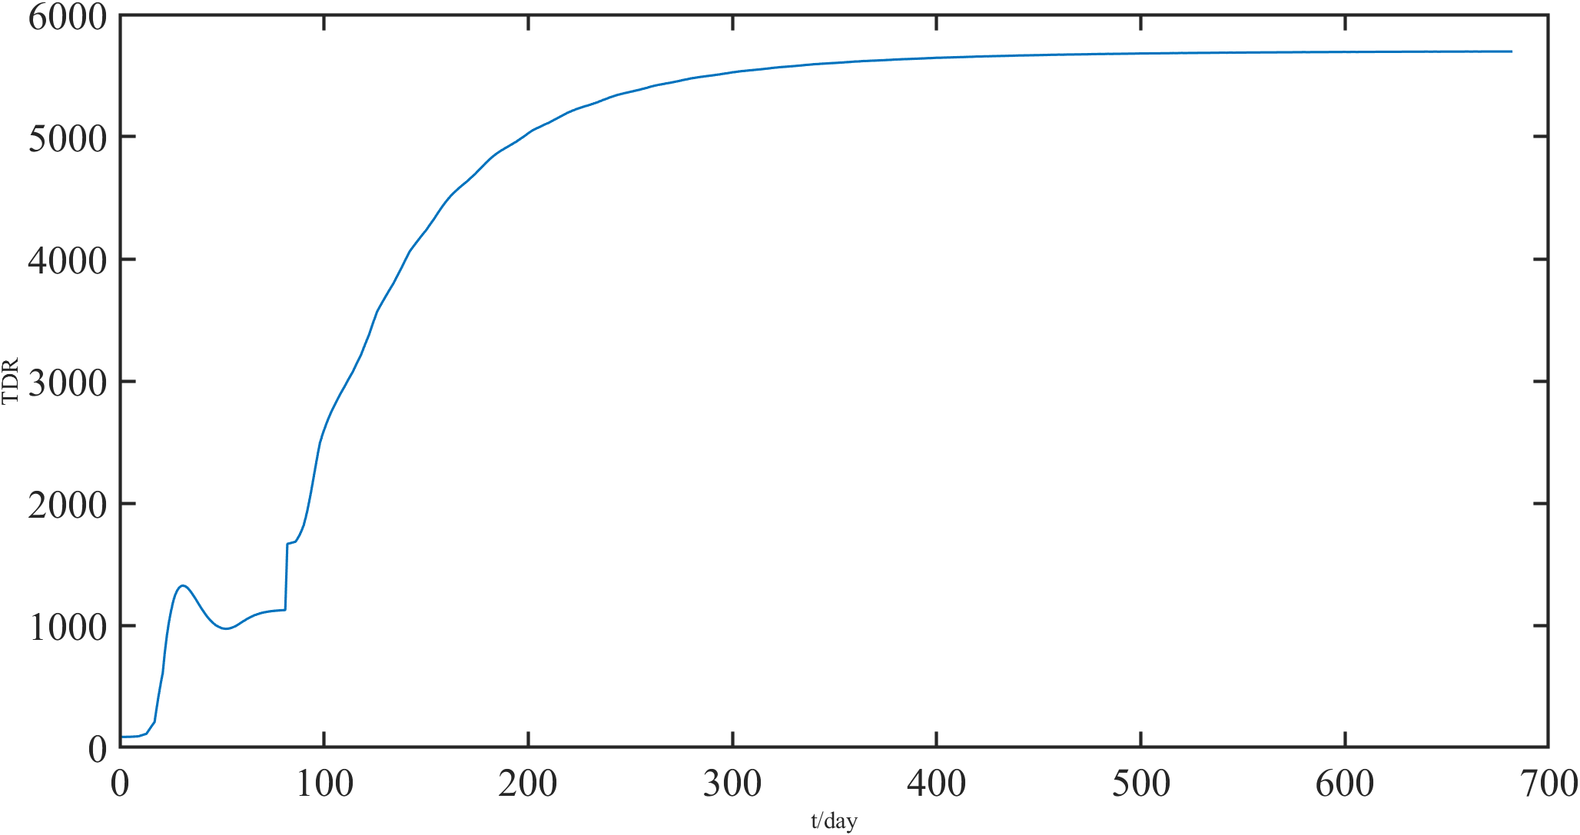
(27,-1)
(a)
(b)
(c)

